Slide 1
C++ Programming Today 2nd Edition By Barbara Johnston Chapter 6
Instructor: <Instructor Name>
Lecture Slides by Kelly Montoya and Rob Garner

Slide 2
Chapter 6
Array Fundamentals
Loops and Arrays
Array Declaration and Initialization
Array Out of Bounds
Vectors and Arrays
Arrays and Functions
Example using Arrays and Functions
Character Arrays
Character Array Initialization
The Null Character
Character Array
Data Structures
Filling Arrays from Data Files
The ifstream and ofstream Classes
Using Char Delimiters with GetLine
Parsing Strings
Converting Strings to Numbers
Multi-dimensional Arrays
Two-Dimensional Array Initialization
Nested for Loops and Two-Dimensional Arrays
Multi-dimensional Arrays and Functions
Common Errors With Arrays

Slide 3
Arrays and Functions
Explain how arrays are passed to functions.

Slide 4
Arrays and Functions
When any array is declared, C++ automatically generates an array pointer, which contains the memory location of the zero-element of the array.
For example, when you declare the following:
float phone_bills[12];
C++ does this automatically :
float *phone_bills = &phone_bills[0];

Slide 5
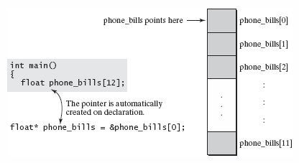
Arrays and Functions
An array pointer is created automatically whenever an array is declared.

Slide 6
Passing Arrays to Functions
The name of the array is a reference (memory location) to the array’s first element.
When we need to pass an array to a function, we are actually passing this reference to it.
We place the array name in the call statement, which passes the address to the function.

Slide 7
Passing Arrays to Functions
The program has only one copy of the array data; the function does not create its own local copy.
A function that uses an array must indicate the array data type in the prototype and function header line.
Using the set of array operator brackets [ ] is how the program identifies the data type as an array.
Notes:
In Program 6-5 we use a function to fill the array, and one for the calculations (summing and averaging). Note how we use a reference to obtain the sum, and return the average value.

Slide 8
Passing Arrays to Functions
The reference to the array is passed to the AskBillData function.

Slide 9
Passing Arrays to Functions
Three important things to notice:
The function prototypes and function header lines indicate the array data type with [ ] .
The call statement has just the array name.
Because the array references in the functions are the functions’ local variables and are merely holding addresses back to main’s array, it is not necessary that the variable names match.

Slide 10
Example using Arrays and Functions
Show an example that illustrates passing arrays to functions.

Slide 11
Example using Arrays and Functions
Generate 100 random numbers and store them in an array.
Use the Bubble Sort sort technique to arrange the array values into numeric order.
The following figure illustrates how one function fills the array, one sorts it, and one writes the array values.
Notes:
Program 6-6 shows how the program has one array and the functions all work on the data.

Slide 12
Example using Arrays and Functions
Functions can fill, sort and write array data.

Slide 13
The Bubble Sort
The Bubble Sort is a sort algorithm that is easy to understand, but painfully slow (in terms of computer speed rating.)
This sort works by comparing adjacent values in the array and begins with the first and second values.
If the first value is larger than the second value, it swaps them.
The sort then compares and swaps if necessary the next two values.

Slide 14
The Bubble Sort
This process continues through the entire array.
The result of one pass has the largest value in the last element.
The sorter then starts over at the second value in the array, and traverses the length of the array again.
When using large amounts of data, avoid the Bubble Sort altogether!

Slide 15
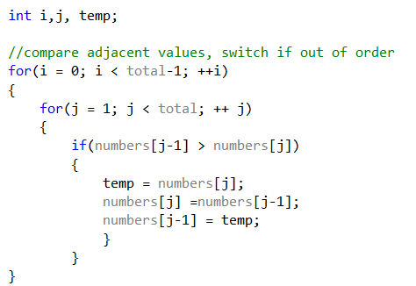
Numbers[5]
0
34
1
64
64
2
12
12
3
35
4
2
i
j
temp
0
1
2
12

Slide 16
Numbers[5]
0
34
1
12
2
64
3
35
4
2

Slide 17
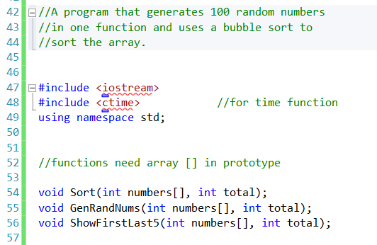
Notes:
From Program 6-6

Slide 18
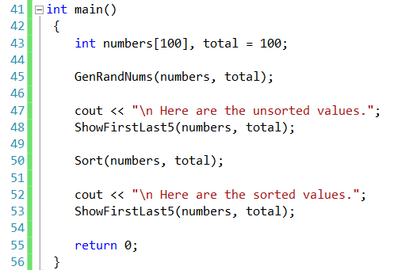

Slide 19
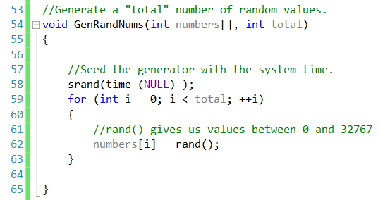

Slide 20
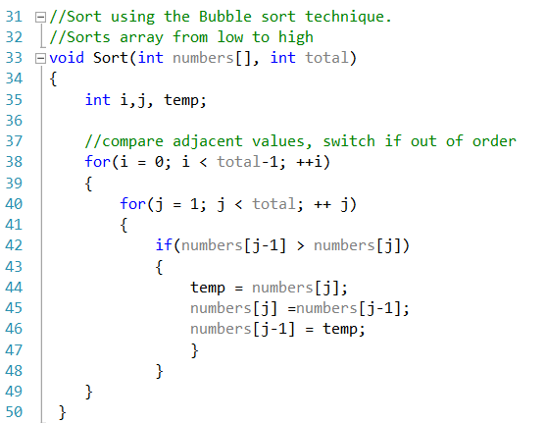

Slide 21
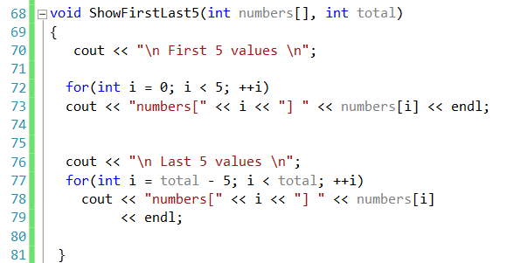

Slide 22
Output
Here are the unsorted values.
First 5 values
numbers[0] 18205
numbers[1] 32434
numbers[2] 12711
numbers[3] 2718
numbers[4] 28005
Last 5 values
numbers[95] 27244
numbers[96] 31614
numbers[97] 22379
numbers[98] 5097
Numbers[99] 13456
Here are the sorted values.
First 5 values
numbers[0] 553
numbers[1] 572
numbers[2] 573
numbers[3] 608
numbers[4] 1254
Last 5 values
numbers[95] 31140
numbers[96] 31614
numbers[97] 32322
numbers[98] 32409
numbers[99] 32434

Slide 23
Chapter 6
Array Fundamentals
Loops and Arrays
Array Declaration and Initialization
Array Out of Bounds
Vectors and Arrays
Arrays and Functions
Example using Arrays and Functions
Character Arrays
Character Array Initialization
The Null Character
Character Array
Data Structures
Filling Arrays from Data Files
The ifstream and ofstream Classes
Using Char Delimiters with GetLine
Parsing Strings
Converting Strings to Numbers
Multi-dimensional Arrays
Two-Dimensional Array Initialization
Nested for Loops and Two-Dimensional Arrays
Multi-dimensional Arrays and Functions
Common Errors With Arrays

